Slide 1

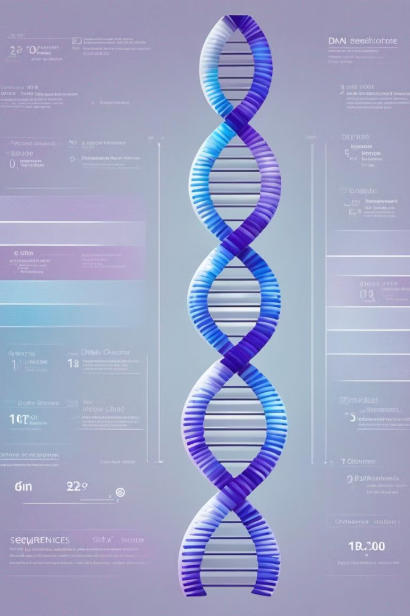
Introduction to Homology searching
Homology searching is a bioinformatics technique used to find similarities between biological sequences, such as DNA, RNA, or protein sequences.
The goal is to identify sequences that are evolutionarily related, implying a common ancestry and often indicating similar functions.
The most common method for homology searching is using sequence alignment algorithms, such as BLAST (Basic Local Alignment Search Tool). These algorithms compare a query sequence against a database of known sequences to find regions of similarity

Slide 2
Introduction to Blast Bioinformatics
Blast Bioinformatics is a powerful tool for comparing biological sequences.
It's widely used in genomics, identifying functional and evolutionary relationships, and analyzing DNA, RNA, and protein sequences.
Understanding Blast tools is crucial for bioinformatics and molecular biology research.

Slide 3

What is blast?
Blast: Basic Local Alignment Search Tool
Function: Identifies regions of similarity between biological sequences
Applications: Sequence alignment, database searching, identification of unknown sequences

Slide 4

Types of Blast Searches
In blast bioinformatics, there are various types of searches including nucleotide-nucleotide, protein-protein, and translated nucleotide-protein searches.
Each type serves distinct purposes and is utilized based on the specific research or analysis requirements.
Blast searches also include specialized options such as PSI-BLAST for sensitive homology detection.

Slide 5

Understanding Blast Results
1
Interpreting Match Scores
Understanding the significance of match scores in blast results.
2
Evaluating E-Values
Assessing the implications of E-values in blast result interpretation.
3
Filtering Out Non-Significant Hits
Strategies for effectively filtering out non-significant hits in blast results.

Slide 6
Parameters and settings for blast
Optimizing Parameters
Database Selection
Filtering Options
Scoring Matrix
Filtering options, such as low complexity and masking, help in refining the search results to eliminate noise.
Selecting the right scoring matrix, like BLOSUM or PAM, influences the alignment and scoring of sequences.
Adjusting parameters like word size and e-value can impact the sensitivity and specificity of the blast search.
Choosing the appropriate database is crucial for achieving accurate and relevant results in blast searches.

Slide 7

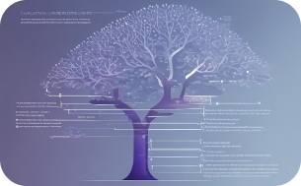


Applications of blast bioinformatics
Diverse Sequence Alignment
Comparative Genomics
Functional Annotation
Motif-Based Analysis
Blast bioinformatics facilitates the visual analysis of diverse sequence alignment patterns with a dynamic and colorful interactive interface, aiding in the interpretation of genetic similarities and differences.
Utilizing a tree-like structure, blast bioinformatics enables the exploration of evolutionary relationships between genes, providing valuable insights for comparative genomics studies.
Blast bioinformatics supports the exploration of intricate molecular pathways and detailed 3D visualizations, aiding in the functional annotation of genes and proteins.
With blast bioinformatics, researchers can perform motif-based sequence analysis, identify conserved motifs, and explore motif clustering, contributing to in-depth motif analysis studies.

Slide 8
Limitations of blast
Database Dependence
Sequence Length Limitations
Blast results can vary based on the database used, which may lead to biased or incomplete findings.
Blast has constraints on the length of sequences it can effectively analyze, potentially missing important information in longer sequences.
Algorithm Sensitivity
Computational Intensity
It may miss detecting distant homologs due to limitations in sensitivity, impacting the comprehensiveness of results.
Complex queries can require significant computational resources and time, affecting efficiency.

Slide 9




Improving blast performance
Optimizing Database
Utilize indexed databases for faster search and improved accuracy.
Enhancing Algorithms
Implement advanced algorithms to increase sensitivity and specificity.
Parallel Processing
Utilize parallel computing to expedite the search process.

Slide 10
Case studies using blast
Genetic Disease Research
Comparative Genomics
Identifying genetic variations linked to diseases for personalized medicine.
Analyzing evolutionary relationships and genomic variations across species.
Metagenomics Analysis
Drug Target Identification
Studying microbial communities in environmental and clinical samples.
Discovering potential drug targets within pathogenic organisms.

Slide 11

Conclusion and Future Developments
Blast bioinformatics has revolutionized genomic research, leading to groundbreaking discoveries and advancements in the field of biological sciences. As technology continues to evolve, future developments in blast are expected to enhance its accuracy, speed, and scope, enabling broader applications in diverse areas such as personalized medicine and environmental conservation.

